Slide 1

„Application of the European Convention on Human Rights in the Case-Law
of the Constitutional Court of Ukraine“
Galyna Yurovska
Judge of the Constitutional Court
of Ukraine

Slide 2
… the Constitutional Court of Ukraine also notes that under certain circumstances, the issue of a person deprived of liberty not being able to visit his or her seriously ill close relative or be present at his or her funeral may be considered in terms of a violation of Article 3 of the Convention, which prohibits torture or inhuman or degrading treatment or punishment.
Decision of December 20, 2023 No. 11-r(ІІ)/2023
the admissibility judgment in the case of Sannino v. Italy 3 May 2005

Slide 3
„the principle of equality of arms – one of the elements of the broader concept of a fair trial – requires each party to be given a reasonable opportunity to present his case under conditions that do not place him at a substantial disadvantage vis-à-vis his opponent“
Decision of March 1, 2023 No. 2-р(II)/2023
Nadtochiy v. Ukraine 15 May 2008

Slide 4
The Constitutional Court of Ukraine … takes into account the provisions of applicable international treaties, ratified by the Verkhovna Rada of Ukraine, and the practice of interpretation and application of these treaties by international bodies whose jurisdiction has been recognized by Ukraine, in particular the European Court of Human Rights.
(Decision of May13, 2024 No. 6-р (II)/2024)

Slide 5
The above is consistent with the Convention, the practice of application of the Convention by the European Court of Human Rights, which, in particular, noted that the right of access to a court must be „practical and effective“, not “theoretical or illusory”, and emphasized that „ observation is particularly true in respect of the guarantees provided for by Article 6, in view of the prominent place held in a democratic society by the right to a fair trial“
Decision of May 13, 2024 No. 6-r(II)/2024
Zubac v. Croatia 5 April 2018

Slide 6
«Article 13 (art. 13) guarantees the availability at national level of a remedy to enforce the substance of the Convention rights and freedoms in whatever form they might happen to be secured in the domestic legal order. The effect of this Article (art. 13) is thus to require the provision of a domestic remedy allowing the competent national authority both to deal with the substance of the relevant Convention complaint and to grant appropriate relief, although Contracting States are afforded some discretion as to the manner in which they conform to their obligations under this provision <…> The scope of the obligation under Article 13
(art. 13) varies depending on the nature of the applicant’s complaint under the Convention <…>. Nevertheless, the remedy required by Article 13 must be „effective“ in practice as well as in law, in particular in the sense that its exercise must not be unjustifiably hindered by the acts or omissions of the authorities of the respondent State» (§ 95).
Decision of May 13, 2024 No. 6-r(II)/2024
„the right of access to a court is not absolute, but its scope should be understood in the context of the positive obligation of the state to provide an effective and efficient remedy for human rights within the meaning of Article 13 of the Convention“
Aksoy v. Turkey 18 December 1996

Slide 7
«it would be inconceivable that Article 6 § 1 should describe in detail procedural guarantees afforded to litigants – proceedings that are fair, public and expeditious – without protecting the implementation of judicial decisions; to construe Article 6 as being concerned exclusively with access to a court and the conduct of proceedings would be likely to lead to situations incompatible with the principle of the rule of law which the Contracting States undertook to respect when they ratified the Convention. Execution of a judgment given by any court must therefore be regarded as an integral part of the “trial” for the purposes of Article 6»
Decision of May 13, 2024 No. 6-r(II)/2024
Shmalko v. Ukraine 20 July 2004

Slide 8
„the right to a court protected by Article 6 would be illusory if a Contracting State’s domestic legal system allowed a final, binding judicial decision to remain inoperative to the detriment of one party“. The effective access to court includes the right to have a court decision enforced without undue delay.
Decision of May 13, 2024 No. 6-r(II)/2024
Yuriy Ivanov v. Ukraine 15 October 2009
Therefore, the Constitutional Court of Ukraine considers that the right to judicial protection established by part one of Article 55 of the Constitution of Ukraine should be considered in connection with the basic principles of legal proceedings defined by part two of Article 129 of the Constitution of Ukraine, and taking into account the right to a fair trial (which includes the state's obligation to enforce a court decision) guaranteed by Article 6 of the Convention.

Slide 9
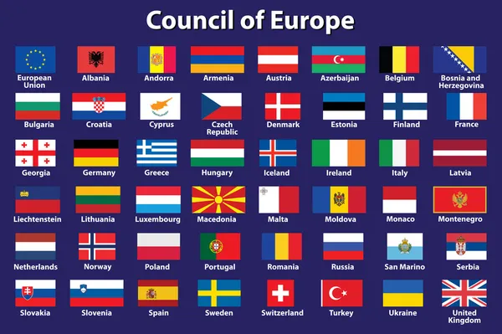

Slide 10
Thank you
for your attention!
Dėkojame už dėmesį!
Дякую за увагу!

